Slide 1
Operating System(22516) Unit-5 Memory Management Marks: 14
Prepared by:
Mrs. Kousar Ayub A.
Lecturer(Selection Grade)
Computer Engg. Dept
M. H. Saboo Siddik Polytechnic

Slide 2
Learning Outcomes
The learners will be able to:
Basic memory management.
Virtual memory.
Page replacement algorithms.

Slide 3
Introduction
Memory management is one of the important function of OS.
Allocating the main memory space to the processes and their data at the time of their execution..
Moves processes back and forth between main memory and disk during execution.
Memory management also perform the activities such as Upgrading the performance of the computer system, Enabling the execution of multiple processes at the same time, Sharing the same memory space among different processes and so on

Slide 4
Functions of Memory Management
Process Isolation: Process isolation means controlling of one process interacts with the data and memory of other process.
Tracking of Memory Locations: Memory management keeps track of each and every memory location, regardless of either it is allocated to some process or it is free. It checks how much memory is to be allocated to processes.
Automatic Allocation and Management: Memory should be allocated dynamically based on the priorities of the process. Otherwise the process waiting will increase and it decreases the CPU utilization and the memory utilization.
Long Term Storage: Long term storage of process will reduce the memory utilization

Slide 5
Functions of Memory Management
Support of Modular Programming: A program is divided into number of modules, if the memory is not sufficient for the entire program, we can load at least some of the modules instead of the entire program. This will increase CPU utilization and memory utilization.
Protection and Access Control: Do not apply the protection mechanisms and access control to all the processes, better to apply to the important applications only. It will save the execution time.
7. Keeping Status of Main Memory Locations: Memory management keeps track of the status of each memory location, whether it is allocated or free.

Slide 6
Memory Management Scheme
Two major memory management schemes are possible. Each approach divides memory into a number of regions or partitions.
Static (Fixed Sized) Memory Partitioning (or Multiprogramming with Fixed number of Tasks (MFT))
Dynamic (Variable) Memory Partitioning (or Multiprogramming with Variable number of Tasks (MVT)).

Slide 7
Static (Fixed Sized) Memory Partitioning
In static memory partitioning, the memory is divided into a number of fixed sized partitions and do not change as the system runs.
Each partition in static memory partitioning, contains exactly one process. So the number of programs to be executed (i.e. degree of multiprogramming) depends on the number of partitions.
There are two alternatives for fixed sized memory partitioning namely, equal sized partitions (a) and unequal sized partitions (b)

Slide 8
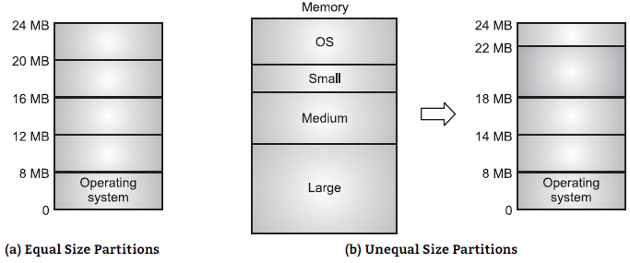
Static (Fixed Sized) Memory Partitioning

Slide 9
Job Scheduling in fixed sized memory partitions
As jobs enter the system, they are put into a job queue.
The job scheduler takes into account the memory requirement of each job and the available regions in determining which jobs are allocated memory.
When a job is allocated space, it is loaded into a region. It can then complete for the CPU. When job terminates, it releases its memory region, which the job scheduler may then fill with another job from the job queue.

Slide 10
MFT with separate queue for each region
If we have three user memory regions of sizes 2K, 6K, and 12K we need three queues namely Q2, Q6 and Q12.
An incoming job requiring 4K of memory would be appended to Q6, a new job needing 8K would be put in Q12, and a job of 2K would go in Q2.
Each queue is scheduled separately. Since each queue has its own memory region, there is no competition between queues for memory.

Slide 11
MFT Advantages and disadvantages
Advantages:
Simple to implement
It requires minimal operating system software and processing overhead as
Fixed partitioning makes efficient utilization of processor and I/O devices
Disadvantages:
The main problem with the fixed partitioning method is how to determine the number of partitions, and how to determine their sizes.
Memory wastage
Inefficient use of memory due to internal fragmentation.
Maximum number of active processes is fixed.

Slide 12
Dynamic (Variable) Memory Partitioning
In variable memory partitioning the partitions can vary in number and size. In variable memory partitioning the amount of memory allocated is exactly the amount of memory a process requires.
The operating system keeps a table indicating which parts of memory are available and which are occupied. Initially all memory is available for user programs and is considered as one large block of available memory, a hole.
When a job arrives and needs memory, we search for a hole large enough for this job. If we find one, we allocate only as much as is needed, keeping the rest available to satisfy future requests.

Slide 13
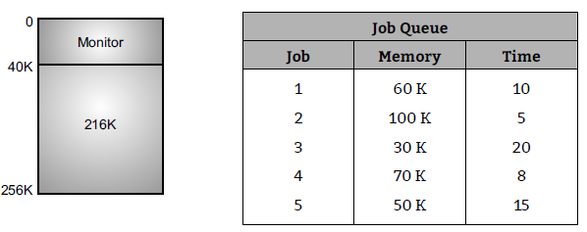
Dynamic (Variable) Memory Partitioning
For example, assume 256K memory available and a resident monitor of 40K. This situation leaves 216K for user programs.

Slide 14
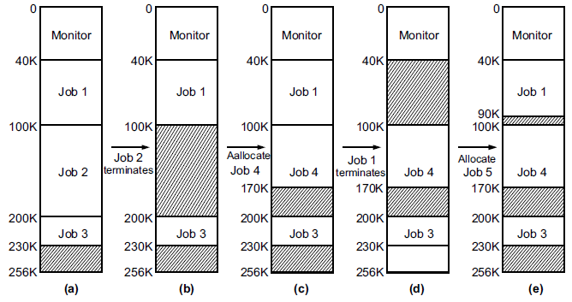
Example memory allocation and job scheduling for MVT

Slide 15
Internal Fragmentation
Internal fragmentation occurs when the memory allocator leaves extra space empty inside of a block of memory that has been allocated for a client.
For example, blocks may be required to be evenly be divided by four, eight or 16 bytes. When this occurs, a client that needs 57 bytes of memory, for example, may be allocated a block that contains 60 bytes, or even 64. The extra bytes that the client doesn’t need go to waste,

Slide 16
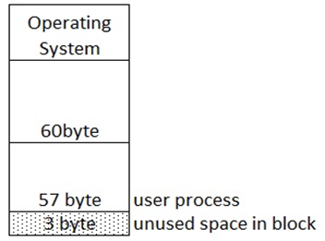
Internal Fragmentation

Slide 17
External Fragmentation
External fragmentation exists when enough total memory space exists to satisfy a request, but it is not contiguous, storage is fragmented into large number of small holes.
For example, there is a hole of 20K and 10K is available in multiple partition allocation schemes. The next process request for 30K of memory. Actually 30K of memory is free which satisfy the request but hole is not contiguous. To there is an external fragmentation of memory.

Slide 18
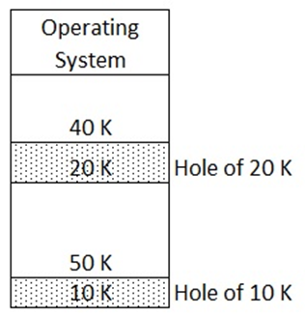
External Fragmentation

Slide 19
Dynamic Storage Allocation
Disk space can be viewed as a large array of disk blocks. At any given time some of these blocks are allocated to files and others are free.
Disk space seen as a collection of free and used segments, each segment is a contiguous set of disk blocks. An unallocated segment is called a Hole. The dynamic storage allocation problem is how to satisfy a request of size ‘n’ from a list of free holes. There are many solutions to this problem.
The set of holes is searched to determine which hole is best to allocate. The most common strategies used to select a free hole from the set of available holes are first fit, best fit and worst fit.

Slide 20
Dynamic Storage Allocation
First Fit: Allocate the first hole (or free block) that is big enough for the new process. Searching can start either at the beginning of the set of holes or where the previous first fit search ended. We can stop searching as soon as we find a large enough free hole. First fit is generally faster.
Best Fit: Allocate the smallest hole that is big enough. We search the entire list, unless the list is kept ordered by size. This strategy produces the smallest left over hole.
Worst Fit: Allocate the largest hole. Again we must search the entire list, unless it is sorted
by size.
First fit and best fit are better than worst fit in both time and storage utilization.
First fit is generally faster

Slide 21
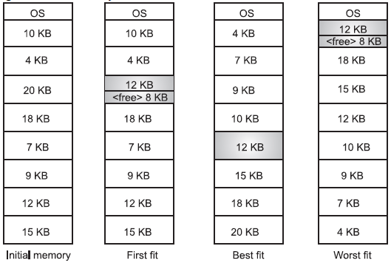
Dynamic Storage Allocation
Consider a swapping system in which memory consists of the following hole sizes in memory order: 10KB, 4KB, 20KB, 18KB, 7KB, 9KB, 12KB and 15KB. Which hole is taken for successive
segment requests for (i) 12 KB (ii) 10KB (iii) 9 KB for first fit, best fit and worst fit.
Sol: Memory arrangements for 12 KB job are as follows:

Slide 22
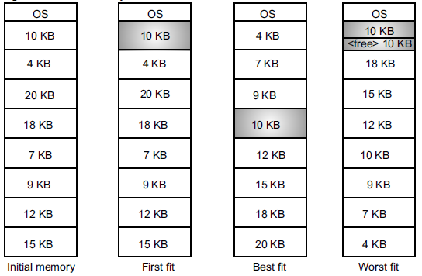
Dynamic Storage Allocation
Sol: Memory arrangements for 10 KB job are as follows:

Slide 23
Free Space Management Techniques
Files are created and deleted frequently during the operation of a computer system. Since there is only a limited amount of disk space, it is necessary to reuse the space from deleted files for new files.
To keep track of free disk space, the file system maintains a free space list. The free space list records all disk blocks, which are free.
To create a file, we search the free space list for the required amount of space and allocate it to the new file. This space is the removed from the free space list. When a file is deleted, its disk space is added to the free space list.
The process of looking after and managing the free blocks of the disk is called free space management. The methods are used in free space management techniques are Bit Vector, Linked List, Grouping and Counting.

Slide 24

Bit Vector
The free space list may not be implemented as a list; it is implemented as a Bit Map or Bit Vector. Bit map is series or collection of bits where each bit corresponds to a disk block.
Each block in bit map is represented by one bit. If the block is free, the bit is ‘0’, if the block is allocated the bit is ‘1’.
For example, consider a disk where blocks 2, 3, 4, 5, 8, 9, 10, 11, 12, 13, 17, 18, 25, 26 and 27 are free, the free space bit map would be, 11000011000000111001111110001111………

Slide 25
Grouping
Grouping is a free space management technique for a modification of the free list method. In grouping, there is a modification of this approach would store the addresses of ‘n’ free blocks in the first free block. The first n-1 of these is actually free. The last one is the disk address of another block containing the addresses of another ‘n’ free block.
The importance of this implementation is that the addresses of a large number of free blocks can be found quickly.
In which a disk block contains addresses of many free blocks and a block containing free block pointers will get free when those blocks are used.

Slide 26
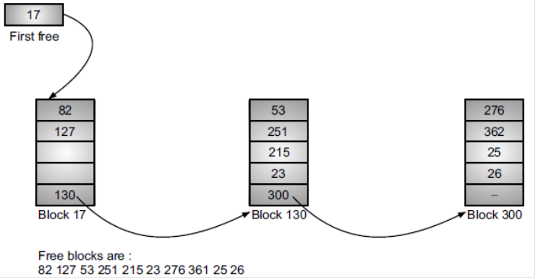
Grouping

Slide 27
Virtual Memory
Virtual memory is a technique which allows the execution of processes that may not be completely in memory.
Virtual memory is the separation of user logical memory from physical memory. This separation allows an extremely large virtual memory to be provided for programmers when only a smaller physical memory is available.
The basic idea behind virtual memory is that the combined size of the program, data and stack may exceed the amount of physical memory available for it.
The operating system keeps those parts of the program currently in use in main memory, and the rest on the disk.

Slide 28
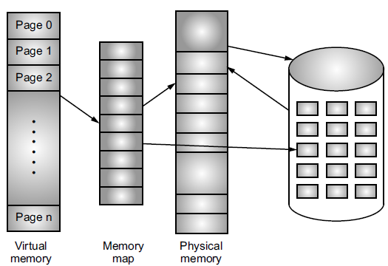
Virtual Memory

Slide 29
Paging
Paging is a memory management technique by which a computer stores and retrieves data from secondary storage for use in main memory. In paging, the operating system retrieves data from secondary storage in same-size blocks called pages.
Paging is an important part of virtual memory implementations in modern operating systems, using secondary storage to let programs exceed the size of available physical memory.
The basic idea behind paging is that when a process is swapped in, the pager only loads into memory those pages that it expects the process to need
Paging permits a programs memory to be non-contiguous, thus allowing a program to be allocated physical memory wherever it is available.

Slide 30
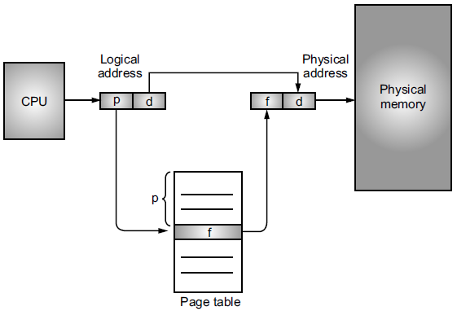
Paging Hardware
Every address generated by the CPU is divided into two parts namely, a page number (p) and a page offset (d).
The page number is used as an index into a page table. The page table contains the base address of each page in physical memory. This base address is combined with page offset to define the physical address that is sent to memory unit.

Slide 31
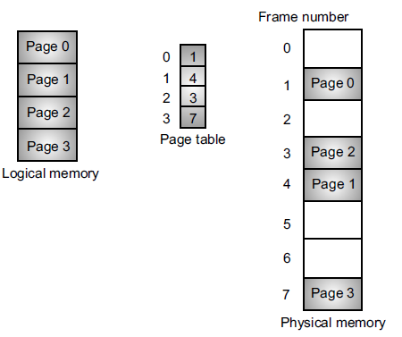
Paging Model of Logical and Physical Memory

Slide 32
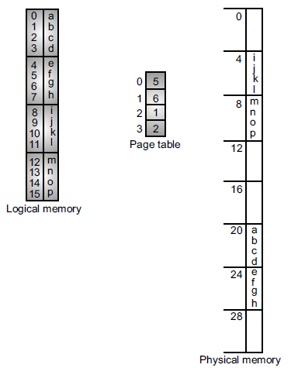
Paging Example for 32 word memory with 4 word pages
For example, using a page size of 4 words and physical memory of 32 words (8 pages) we show how the user’s view of memory can be
mapped into physical memory. Logical address 0 is page 0 offset 0. We find that page 0 is in frame 5.
Thus logical address 0 maps to physical address 20 = (5 × 4 + 0). Logical address 4 is page1, offset 0. Logical address 4 maps to physical address (6 × 4 + 0) = 24.

Slide 33
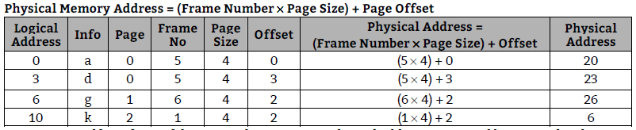
Paging

Slide 34
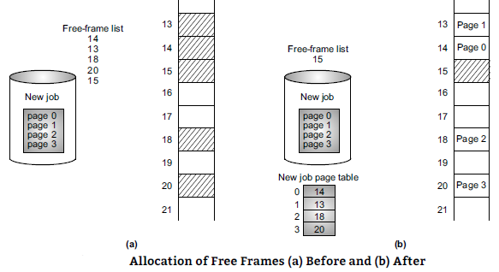
Paging
Paging itself is a form of dynamic relocation. Every logical address is mapped by paging hardware to some physical address. Each user page needs one frame. Thus if the job requires n pages, there must be n frames available in memory.
The page of job is loaded into one of the allocated frames and the frame number is put in the page table for this job and so on. Using a paging scheme we have no external fragmentation, any free frame can be allocated to a job that needs it. Each jobs has its own page table. The page table is
implemented as a set of dedicated registers.

Slide 35
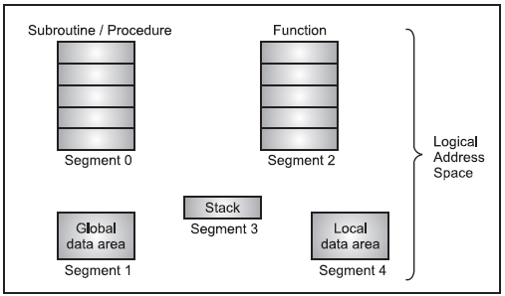
Segmentation
Like paging segmentation is also a memory management scheme that implements the user’s view of a program.
In segmentation, the entire logical address space is considered as a collection of segments with each segment having a number and a length.
The length of a segment may range from 0 to some maximum value as specified by the hardware and may also change during the execution. The user specifies each logical address consisting of a segment number (s) and an offset (d).
A segment is a logical unit such as main program, procedure, function, method, object, local variables, global variables, common block, stack, symbol table, arrays etc.

Slide 36
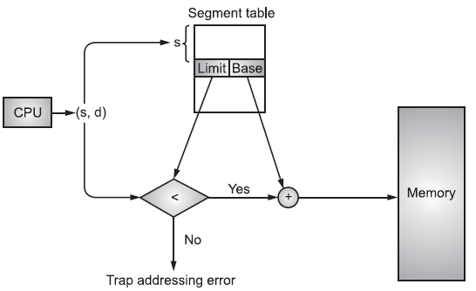
Segmentation Hardware
A segment is defined as, a logical grouping of instructions. A logical address space is a collection of segments. Every program/job is collection of segments such as subroutine, array etc.
Each segment has a name and a length. Address specify both the segment name and the offset within the segment. The user specifies each address by two quantities a segment name and an offset.
A logical address consists of two parts a segment number ‘s’ and an offset into that segment ‘d’. The segment number is used as an index into segment table. Each entry of segment table has a segment base and a segment limit.

Slide 37
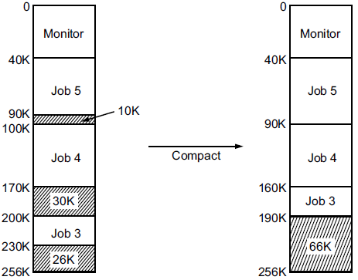
Compaction
Compaction is a method used to overcome the external fragmentation problem. All free blocks are brought together as one large block of free space.
The collection of free space from multiple non-contiguous blocks into one large free block in a system's memory is called compaction.
Compaction is possible only if relocation is dynamic, at execution time, using base and limit registers. The simplest compaction algorithm is to simply move all jobs towards one end of memory, all holes move in the other direction, producing on large hole of available memory.

Slide 38
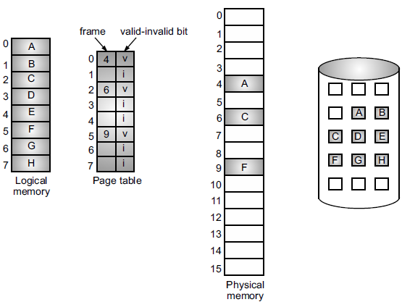
Page table when some pages are not in main memory

Slide 39
Demand Paging
Demand paging is a method of virtual memory management.
With demand-paged virtual memory, pages are only loaded when they are demanded during program execution; pages that are never accessed are thus never loaded into physical memory.
A demand-paging system is similar to a paging system with swapping, where processes reside in secondary memory (usually a disk). When we want to execute a process, we swap it into memory.
Rather than swapping the entire process into memory, however, we use a lazy swapper called pager. A lazy swapper never swaps a page into memory unless that page will be needed.
When a process is to be swapped in, the pager guesses which pages will be used before the process is swapped out again. Instead of swapping in a whole process, the pager brings only those necessary pages into memory.

Slide 40
Page Replacement Algorithms
When the processor needs to execute a page, and if that page is not available in main memory then this situation is called page fault.
For bringing in the required page into main memory, if the space is not available in memory then we need to remove the page from the main memory for allocating the space to the new page which needs to be executed.
When a page fault occurs, the operating system has to choose a page to remove from memory to make room for the page that has to be brought in. This is known as page replacement.

Slide 41
FIFO (First In First Out) Page Replacement Algorithm
The simplest page replacement algorithm is a FIFO.
A FIFO replacement algorithm associates with each page the time when that page was brought into memory.
When a page must be replaced, the oldest page is chosen.
FIFO queue is created to hold all pages in memory. We replace the page at the head of the queue.
When a page is brought into memory, we insert it at the tail of the queue.
The FIFO page replacement algorithm is easy to understand and program. It performance is not always good.

Slide 42
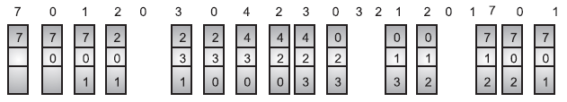
FIFO (First In First Out) Page Replacement Algorithm
consider the following reference string: 7, 0, 1, 2, 0, 3, 0, 4, 2, 3, 0, 3, 2, 1, 2, 0..1.7.0.1
The three frames are initially empty.
There are 15 faults altogether

Slide 43
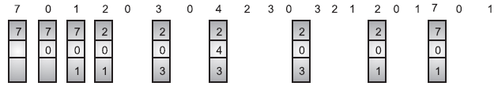
Optimal Page Replacement Algorithm
An optimal page replacement algorithm has the lowest page fault rate of all algorithms and would never suffer from Belady’s anomaly.
Optimal replacement algorithm states replace that page which will not be used for the longest period of time.
consider the following reference string , 7, 0, 1, 2, 0, 3, 0, 4, 2, 3, 0, 3, 2, 1, 2, 0, 1, 7, 0, 1.

Slide 44
LRU (Least Recently Used) Page Replacement Algorithm
If we use the recent past as an approximation of the near future, then we would replace that page which has not been used for the longest period of time. This is the least recently used algorithm.
LRU replacement associates with each page the time of its last use. When a page is to be replaced, LRU chooses that page which has not been used for the longest period of time.
We can think of this strategy as the optimal page-replacement algorithm looking backward in time, rather than forward.

Slide 45
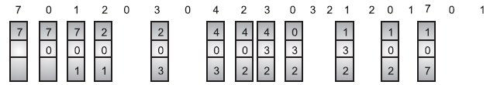
LRU (Least Recently Used) Page Replacement Algorithm
For example consider the following reference string, 7, 0, 1, 2, 0, 3, 0, 4, 2, 3, 0, 3, 2, 1, 2, 0, 1, 7, 0, 1.
No. of page faults = 12.

Slide 46
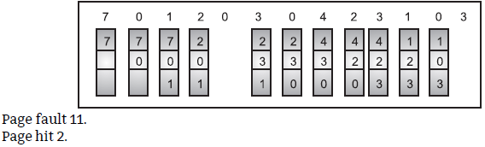
Example
Q. Explain FIFO (First In First Out) page replacement algorithm for reference string
7012030423103. (4m)
Sol: A FIFO replacement associates with each page the time when that page was bought into memory. When the page must be replaced, the oldest page is chosen. It maintains a FIFO queue to hold all pages in memory. We replace the page at the head of the queue. When a page is brought into the memory. We insert it at the tail of the queue.Consider three frames are available.
No. of page faults = 12.

Slide 47
Thank you
Q. Explain FIFO (First In First Out) page replacement algorithm for reference string
7012030423103. (4m)
Sol: A FIFO replacement associates with each page the time when that page was bought into memory. When the page must be replaced, the oldest page is chosen. It maintains a FIFO queue to hold all pages in memory. We replace the page at the head of the queue. When a page is brought into the memory. We insert it at the tail of the queue.Consider three frames are available.
No. of page faults = 12.

Slide 48
Thank you
Q. Explain FIFO (First In First Out) page replacement algorithm for reference string
7012030423103. (4m)
Sol: A FIFO replacement associates with each page the time when that page was bought into memory. When the page must be replaced, the oldest page is chosen. It maintains a FIFO queue to hold all pages in memory. We replace the page at the head of the queue. When a page is brought into the memory. We insert it at the tail of the queue.Consider three frames are available.
No. of page faults = 12.

Slide 49
Thank you…..
You can mail your Queries to :
a2kousarj@gmail.com

